Slide 1

COURSERA CAPSTONE IBM APPLIED DATA SCIENCE CAPSTONE OPENING A NEW Indian RESTAURANT IN SAN DIEGO, CALIFORNIA
By: Vishvajit Indurkar

Slide 2

Business Problem
Location of the Indian Restaurant is one of the most important decisions that will determine whether the restaurant will be a success or a failure
Objective: To analyze and select the best locations in San Diego, CA to open a new Indian Restaurant
This project is timely as the city is currently suffering from oversupply of Indian Restaurants
Business question
In San Diego, if a property developer is looking to open a new Indian Restaurant, where would you recommend that they open it?

Slide 3
Data
• Data required
• List of neighbourhoods in San Diego
• Latitude and longitude coordinates of the neighbourhoods
• Venue data, particularly data related to Indian restaurants
• Sources of data ➢
• Wikipedia page for neighbourhoods (https://en.wikipedia.org/wiki/Category:Neighborhoods_in_San_Diego)
• Geocoder package for latitude and longitude coordinates
• Foursquare API for venue data

Slide 4
Methodology
• Web scraping Wikipedia page for neighborhoods list
• Get latitude and longitude coordinates using Geocoder
• Use Foursquare API to get venue data
• Group data by neighborhood and taking the mean of the frequency of occurrence of each venue category • Filter venue category by Indian restaurants
• Perform clustering on the data by using k-means clustering
• Visualize the clusters in a map using Folium

Slide 5
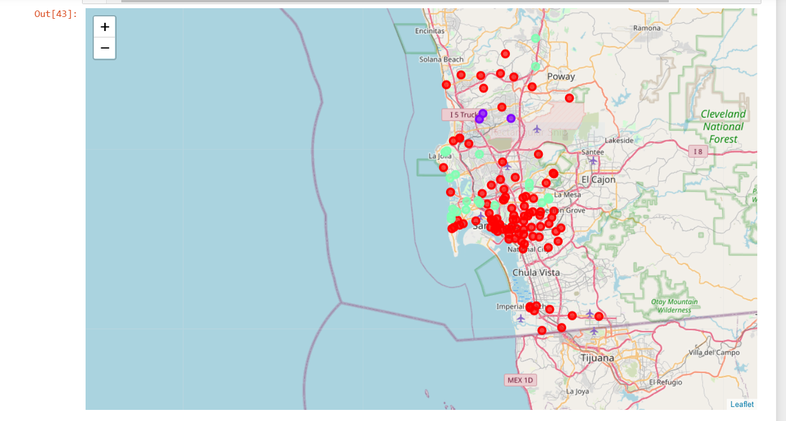
Results
Categorized the neighborhoods into 3 clusters:
❑ Cluster 1: Neighborhoods with low number to no existence of Indian Restaurants
❑ Cluster 2: Neighborhoods with moderate number of Indian Restaurants
❑ Cluster 0: Neighborhoods with high concentration of Indian Restaurants

Slide 6
Discussion
Most of the Indian restaurants are concentrated in the central area of San Diego
Highest number is in cluster 0 and moderate number in cluster 2
Cluster 1 has very low number to no Indian Restaurants in the neighborhoods
Over saturation of Indian restaurants are mostly visible in the central area of the city, with the suburbs having only a few

Slide 7
Recommendations
• Open new Indian Restaurants in neighborhoods in cluster 1 with little to no competition
• We can also open in neighborhoods in cluster 2 with moderate competition along with a unique selling point to stand out from the competition
• Avoid neighborhoods in cluster 2, they already have a high concentration of Indian Restaurants and intense competitio

Slide 8
Conclusion
• Answer to business question: The neighborhoods in cluster 0 are the most preferred locations to open a new Indian Restaurant
• The findings of this project will help the relevant stakeholders to capitalize on locations with a high potential for success. while avoiding overcrowded areas in their decisions to open a new Indian Restaurant

